Slide 1


Lorenzo Anastasi
17 July 2025

Slide 2

Outline
Executive Summary
Introduction
Methodology
Results
Conclusion
Appendix

Slide 3
Executive Summary
Summary of methodologies
Data collection with API;
Data collection with Web Scraping;
Data Wrangling;
Exploratory Data Analysis with Visualization;
Exploratory Data Analysis with SQL;
Interactive Visual Analytics with Folium;
Interactive Visual Analytics with Plotly Dash;
Predictive Analysis.
Summary of all results
Exploratory Data Analysis results;
Interactive Visual Analytics results
Predictive Analysis results.

Slide 4
Introduction
Project background and context
SpaceX advertises Falcon 9 rocket launches on its website, with a cost of 62 million dollars; other providers cost upward of 165 million dollars each, much of the savings is because SpaceX can reuse the first stage. Therefore, if we can determine if the first stage will land, we can determine the cost of a launch. This information can be used by an alternate company who wants to bid against SpaceX for a rocket launch.
Problems you want to find answers
Which data, publicly available on SpaceX site, can determine the successful of a landing;
What are the inter-relations between the gathered data;
What is the best model to predict the result of a landing.

Slide 5

Section 1

Slide 6
Methodology
Executive Summary
Data collection methodology:
Data is gathered from an API, specifically the SpaceX REST API, available at: api.spacexdata.com/v4/
Data is also gathered scraping Wiki pages related to Falcon 9 Launch data.
Perform data wrangling
The mainly objective of this methodology is to convert the outcomes into Training Labels with 1 means the booster successfully landed 0 means it was unsuccessful.
Perform exploratory data analysis (EDA) using visualization and SQL
Perform interactive visual analytics using Folium and Plotly Dash
Perform predictive analysis using classification models
We have built a machine learning pipeline to predict if the first stage of the Falcon 9 lands successfully. This have included: Preprocessing, allowing us to standardize our data, and Train_test_split, allowing us to split our data into training and testing data, We will train the model and perform Grid Search, allowing us to find the hyperparameters that allow a given algorithm to perform best. Using the best hyperparameter values, we will determine the model with the best accuracy using the training data.

Slide 7
Data Collection
Describe how data sets were collected.
Data is gathered from an API, specifically the SpaceX REST API, available at:
api.spacexdata.com/v4/
Data is also gathered scraping Wiki pages related to Falcon 9 Launch data at this URL:
https://en.wikipedia.org/wiki/List_of_Falcon_9_and_Falcon_Heavy_launches

Slide 8
Data Collection – SpaceX API
SpaceX offers publicly available data via REST API.
The flowchart on the right shows the tasks of the Data Collection methodology.
Source code available publicly at:
https://github.com/lodovico65/spacey/blob/main/spacex-data-collection-api.ipynb
Request and parse the data
Filter only Falcon 9 launches
Dealing with missing values

Slide 9
Data Collection - Scraping
Data is also gathered scraping Wiki pages related to Falcon 9 Launch data.
The flowchart on the right shows the tasks of the Data Collection methodology.
Source code publicly available at:
https://github.com/lodovico65/spacey/blob/main/webscraping.ipynb
Request Falcon 9 Launch Wiki page
Extract cols/vars names from HTML table header
Create dataframe parsing launch HTML tables

Slide 10
Data Wrangling
We have performed some Exploratory Data Analysis (EDA) to find some patterns in the data and determine what would be the label for training supervised models.
The following flowchart shows the tasks of the Data Wrangling methodology:
Source code publicly available at:
https://github.com/lodovico65/spacey/blob/main/spacex-Data%20wrangling.ipynb
Calculate the num of lauches on each site
Calculate the num and occurence of each orbit
Calculate the num and occurence of mission outcome of orbits
Create a landing outcome label from Outcome col

Slide 11
EDA with Data Visualization
We have performed EDA with Data Visualization using Pandas and Matplolib. The following charts have been plotted:
Visualize the relationship between Flight Number and Launch Site with scatter plot;
Visualize the relationship between Payload Mass and Launch Site with scatter plot;
Visualize the relationship between success rate of each orbit type with bar chart;
Visualize the relationship between FlightNumber and Orbit type with scatter plot;
Visualize the relationship between Payload Mass and Orbit type with scatter plot;
Visualize the launch success yearly trend with line chart.
This is the URL of the completed EDA with data visualization notebook:
https://github.com/lodovico65/spacey/blob/main/edadataviz.ipynb

Slide 12
EDA with SQL
We have performed EDA with SQL using SQLAlchemy, prettytable and sqlite3. The following SQL queries have been performed:
Display the names of the unique launch sites in the space mission;
Display 5 records where launch sites begin with the string 'CCA’;
Display the total payload mass carried by boosters launched by NASA (CRS);
Display average payload mass carried by booster version F9 v1.1;
List the date when the first succesful landing outcome in ground pad was acheived.;
List the names of the boosters which have success in drone ship and have payload mass greater than 4000 but less than 6000;
List the total number of successful and failure mission outcomes;
List all the booster_versions that have carried the maximum payload mass, using a subquery with a suitable aggregate function;
List the records which will display the month names, failure landing_outcomes in drone ship ,booster versions, launch_site for the months in year 2015;
Rank the count of landing outcomes (such as Failure (drone ship) or Success (ground pad)) between the date 2010-06-04 and 2017-03-20, in descending order;
This is the URL of the completed EDA with SQL:
https://github.com/lodovico65/spacey/blob/main/eda-sql.ipynb

Slide 13
Build an Interactive Map with Folium
Firstly, we have to use the Map() function to create a map.
The Circle() function permit to circle the coordinates by entering parameters such as radius and color. We have used the function to draw a small circle near the city of Houston;
The Marker() function permit to mark the location of the coordinates and set the location name by using the popup parameter. We have used the function to mark launch sites like ‘NASA JSC’;
The MarkerCluster() function permit to handle many markers and can help to declutter the map;
The Line() function can be used to show the distance between two points on the map.
The GitHub URL of the completed interactive map with Folium map is available at:
https://github.com/lodovico65/spacey/blob/main/launch_site_location.ipynb

Slide 14
Build a Dashboard with Plotly Dash
The Plotly Dashboard shows the total success launch for all sites and for a specific launch site;
The Dashboard also shows a scatter plot with the correlation between Payload Mass in Kg for all sites and for a specific launch site;
The URL of the completed Plotly Dash lab is publicly available at:
https://github.com/lodovico65/spacey/blob/main/spacex-dash-app.py

Slide 15
Predictive Analysis (Classification)
We have built a machine learning pipeline to predict if the first stage of the Falcon 9 lands successfully.
This has included:
Preprocessing, allowing us to standardize our data;
Train_test_split, allowing us to split our data into training and testing data,
Train the model and perform Grid Search, allowing us to find the hyperparameters that allow a given algorithm to perform best.
Using the best hyperparameter values for determine the model with the best accuracy using the training data.
We have tested Logistic Regression, Support Vector machines, Decision Tree Classifier, and K-nearest neighbors.
Finally, we output the confusion matrix.
The URL of the completed predictive analysis lab:
https://github.com/lodovico65/spacey/blob/main/Machine%20Learning%20Prediction.ipynb

Slide 16
Results
Exploratory data analysis results
There are four launch sites in the SpaceX missions;
The average of Payload Mass in kg carried by booster version F9 v1.1 is 2928.4
The date of the first successful landing outcome in ground was achieved on December 22, 2015;
Many F9 booster with payload mass greater than the average have nevertheless been successful in drone ship;
The success rate is very high with a count of 100 success vs 1 failure;
The success rate since 2013 kept increasing till 2020.

Slide 17
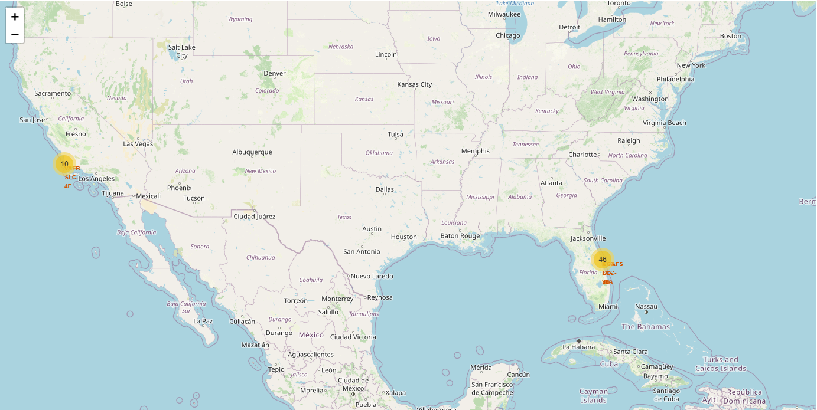
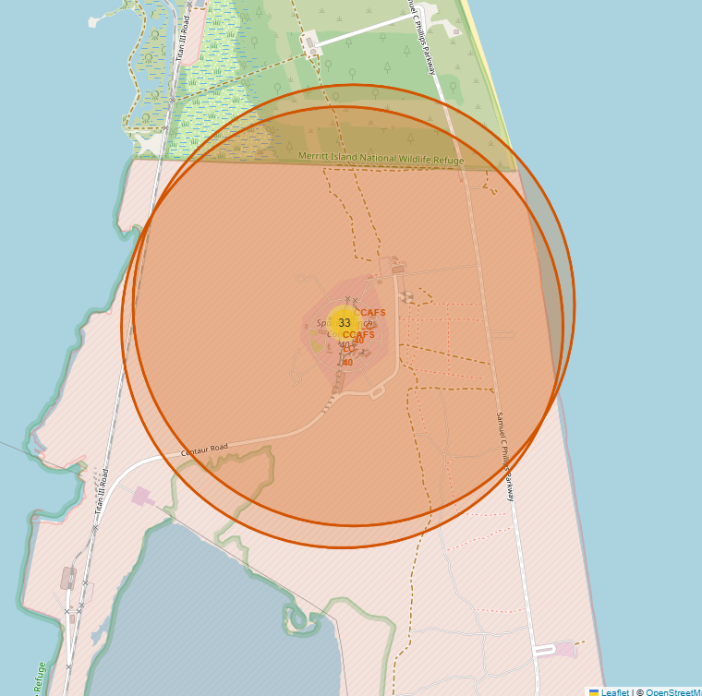
Results
Interactive analytics in screenshots:
Three launch sites are in close proximity to Equator line. One VAFB-SLC-4E is less close to the Equator line. All launch sites are in very close proximity to the coast;
Most of the launches site are on the East coast;
In the launch site proximity is easy to find railway, highway, coastline.

Slide 18
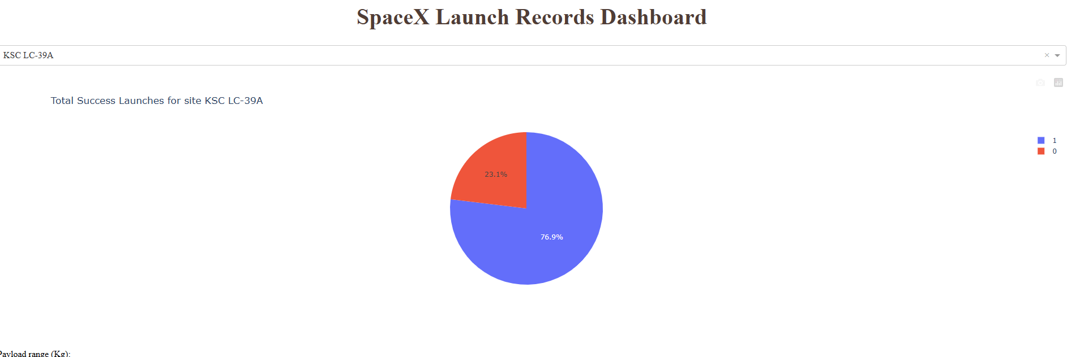
Results
Interactive analytics in screenshots:
We found that the site with the greater success rate 76.9% is KSC LC-39A

Slide 19
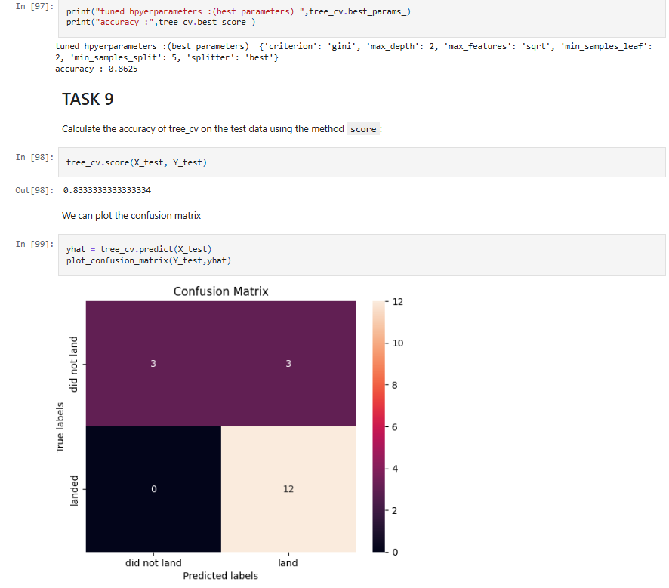
Results
Predictive analysis results:
In the predictive analysis phase, we have:
Created a column for the class;
Standardized the data;
Split into training data and test data;
Find best Hyperparameter for SVM, Classification Trees and Logistic Regression.
Find that the Decision Tree is the method that performs best;

Slide 20

Section 2

Slide 21
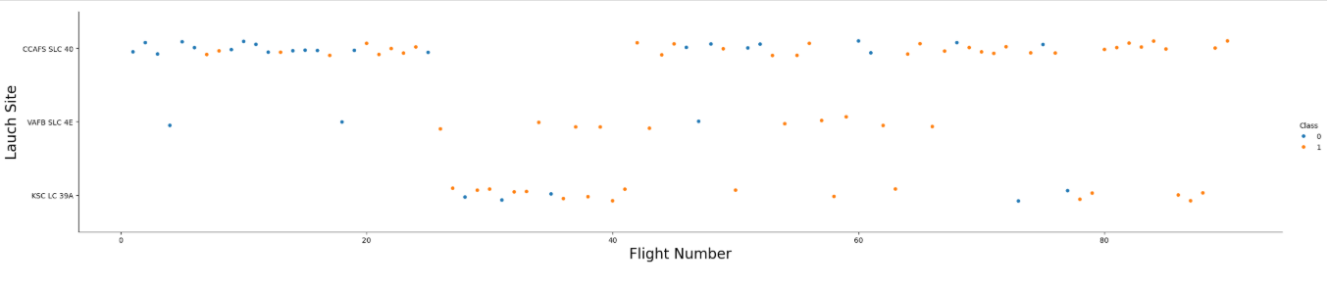
Flight Number vs. Launch Site
The chart shows that the success rate increases with the number of flights:

Slide 22
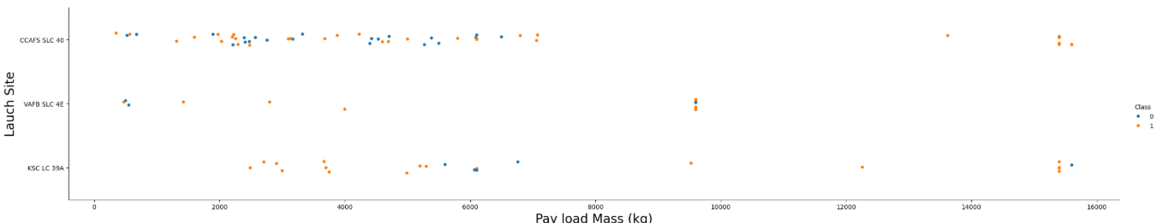
Payload vs. Launch Site
Examining Payload Mass Vs. Launch Site scatter point chart you will find that for the VAFB-SLC launch site there are no rockets launched for heavy payload mass (greater than 10000):

Slide 23
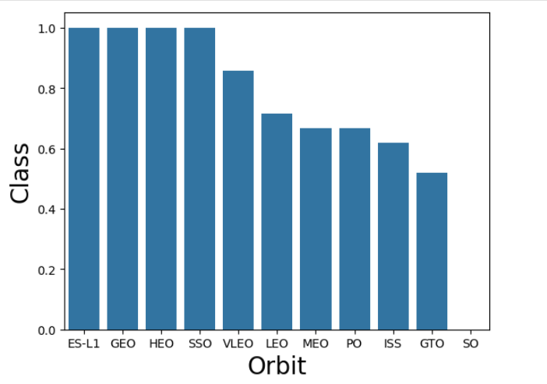
Success Rate vs. Orbit Type
The chart shows that the Orbit types with the highest success rate are: ES-L1, GEO, HEO, SSO.

Slide 24
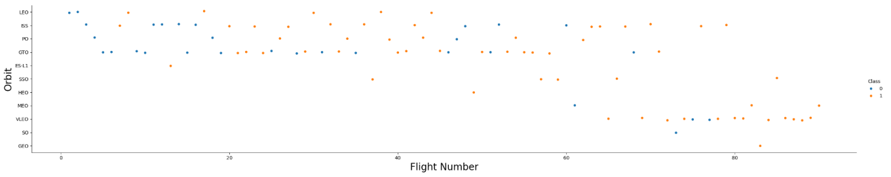
Flight Number vs. Orbit Type
The chart shows that in the LEO orbit, success seems to be related to the number of flights. Conversely, in the GTO orbit, there appears to be no relationship between flight number and success.

Slide 25
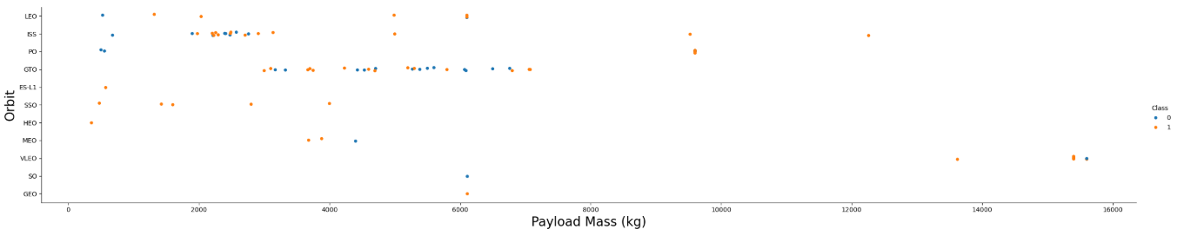
Payload vs. Orbit Type
The chart shows that with heavy payloads the successful landing or positive landing rate are more for Polar, LEO and ISS. However, for GTO, it's difficult to distinguish between successful and unsuccessful landings as both outcomes are present.

Slide 26
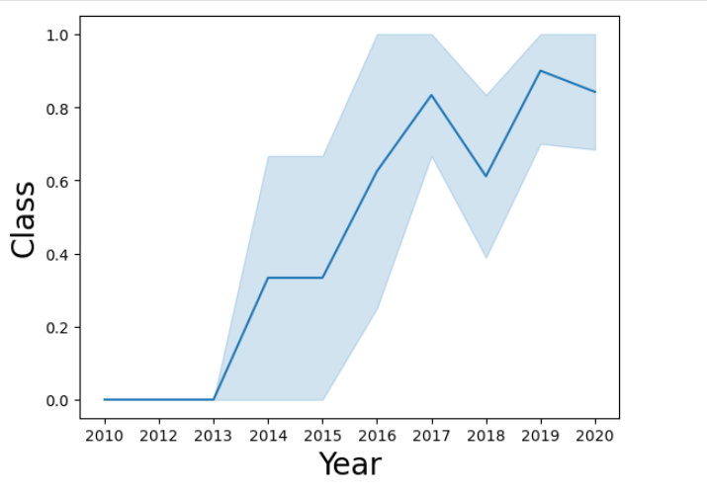
Launch Success Yearly Trend
The chart shows that the success rate since 2013 kept increasing till 2020.

Slide 27
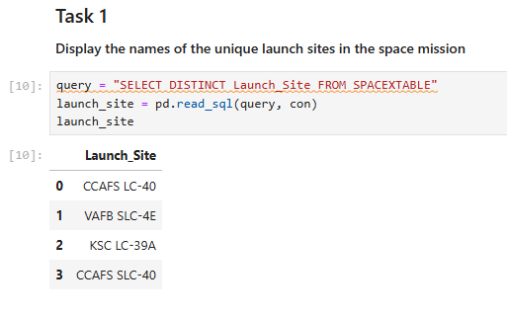
All Launch Site Names
Find the names of the unique launch sites:
We have used the “DISTINCT” clause to retrieve a list of unique launch sites;

Slide 28
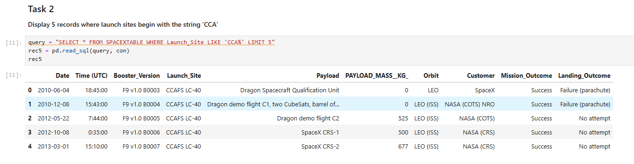
Launch Site Names Begin with 'CCA'
Find 5 records where launch sites begin with `CCA`:
We have used the LIKE operator for search based on a specific pattern in a column. We have also restricted the retrieve to 5 records using the LIMIT clause;

Slide 29
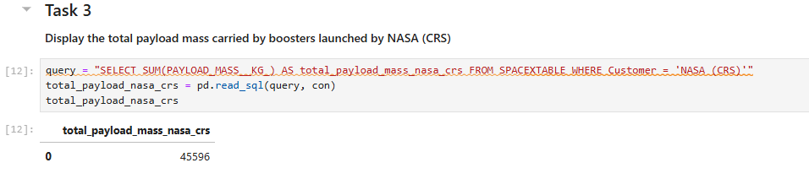
Total Payload Mass
Calculate the total payload carried by boosters from NASA:
We have used the SUM() function to calculate the sum of the Payload Mass in kg (equal to 45596) for the Customer ‘NASA (CRS);

Slide 30
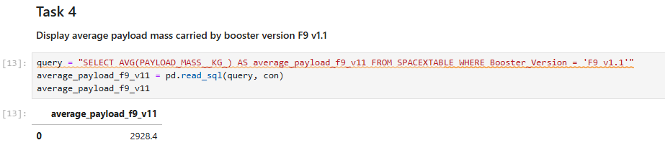
Average Payload Mass by F9 v1.1
Calculate the average payload mass carried by booster version F9 v1.1:
We have used the AVG() function to calculate the mean of the Payload Mass in kg (equal to 2928.4) for the F9 v1.1 booster version;

Slide 31
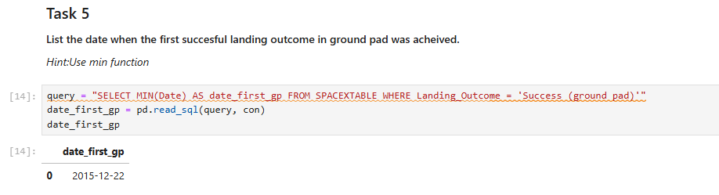
First Successful Ground Landing Date
Find the dates of the first successful landing outcome on ground pad:
We have used the MIN() function to calculate the date (equal to 22 December 2015) of the first successful landing outcome on ground pad;

Slide 32
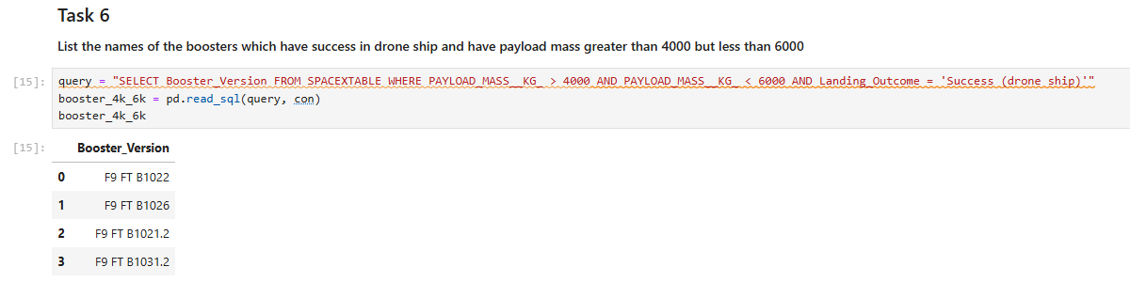
Successful Drone Ship Landing with Payload between 4000 and 6000
List the names of boosters which have successfully landed on drone ship and had payload mass greater than 4000 but less than 6000:
We have used the comparison operator ‘>’ (greater than) and ‘<‘ (less than) to retrieve the records with Payload Mass within the specified interval;

Slide 33
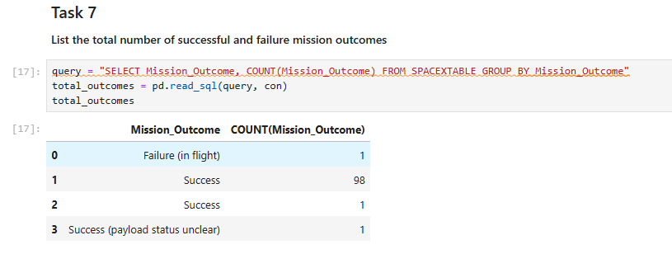
Total Number of Successful and Failure Mission Outcomes
Calculate the total number of successful and failure mission outcomes:
We have used the aggregate statement GROUP BY to counts the occurrences of each Mission Outcome;

Slide 34
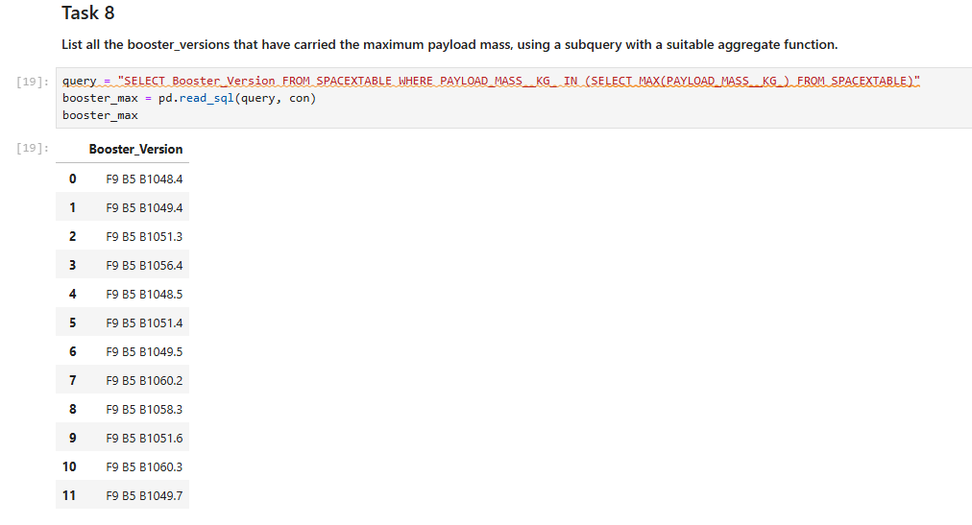
Boosters Carried Maximum Payload
List the names of the booster which have carried the maximum payload mass:
We have used a subquery with the MAX() function to retrieve the booster with the specified condition;

Slide 35
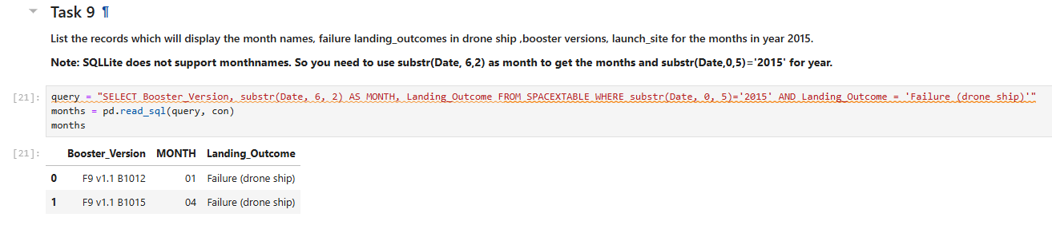
2015 Launch Records
List the failed landing_outcomes in drone ship, their booster versions, and launch site names for in year 2015:
We have used the substr() function to return the month portion of the Date;

Slide 36
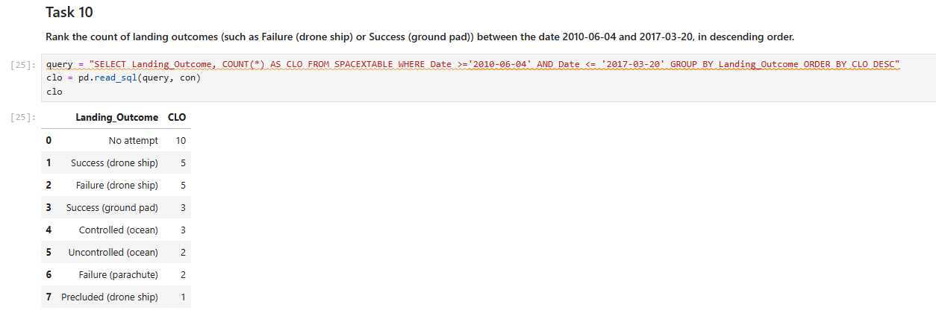
Rank Landing Outcomes Between 2010-06-04 and 2017-03-20
Rank the count of landing outcomes (such as Failure drone ship) or Success (ground pad) between the date 2010-06-04 and 2017-03-20, in descending order:
We have used the aggregate statement GROUP BY and the COUNT() function to retrieve the count of landing outcomes;

Slide 37

Section 3

Slide 38
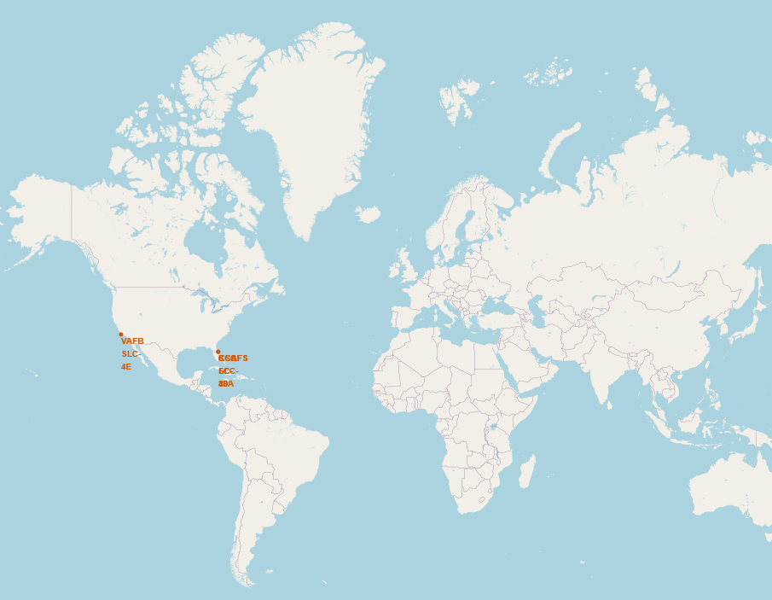
Launch sites location markers on global map
Three launch sites are in close proximity to Equator line. One VAFB-SLC-4E is less close to the Equator line. All launch sites are in very close proximity to the east and west coast.

Slide 39
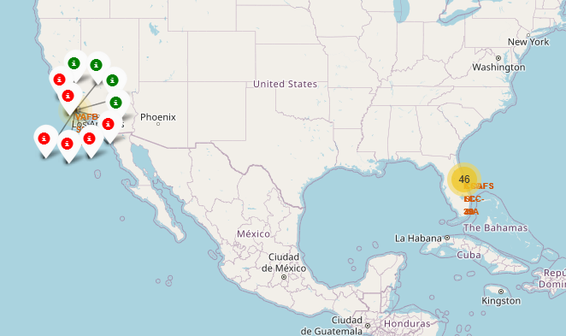
Map with color-labeled launch outcomes
California launch sites. The green markers
refers to successful landing, the red markers
to unsuccessful landing.

Slide 40
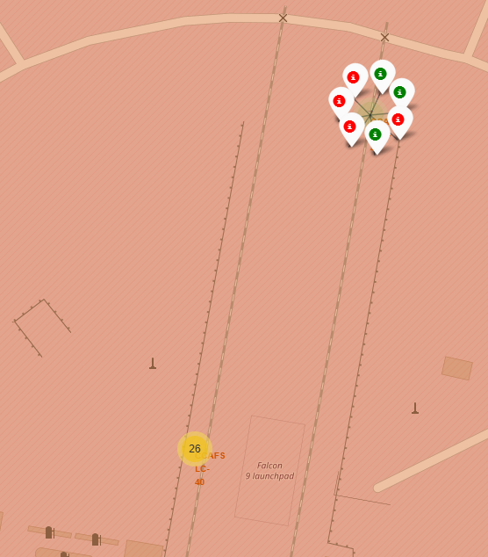
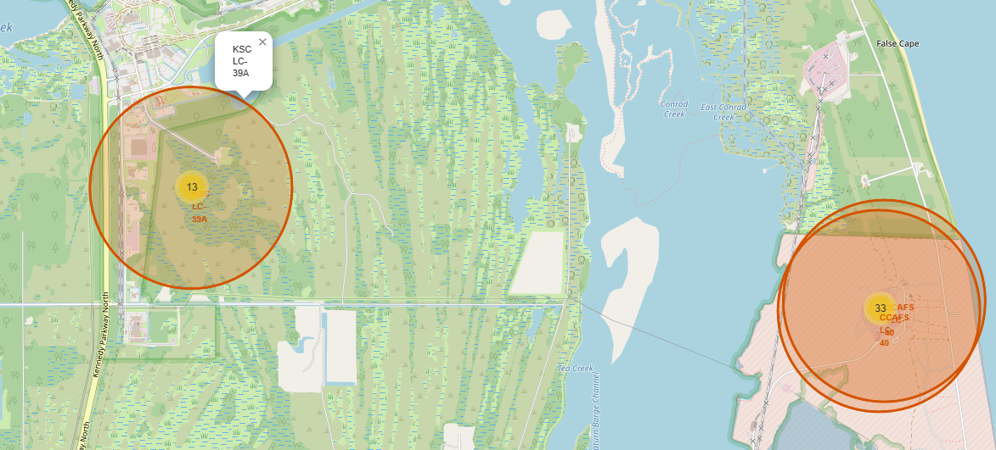
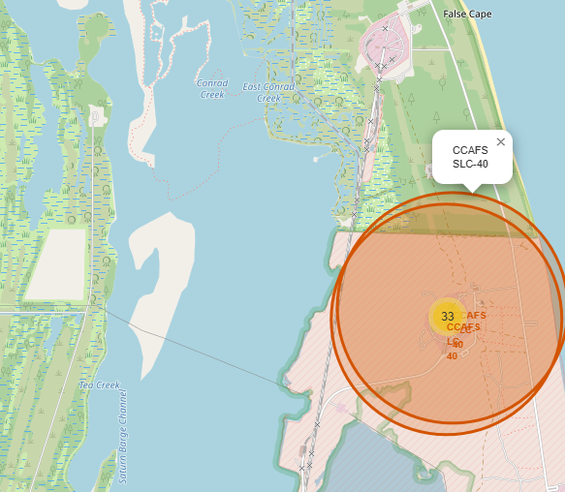
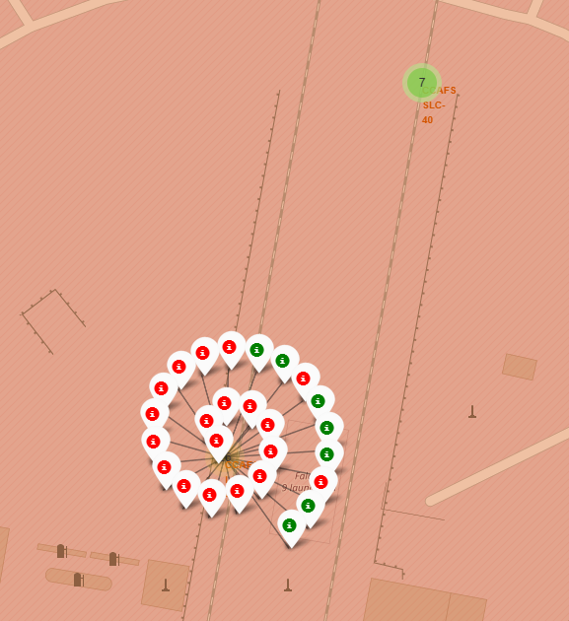
Map with color-labeled launch outcomes
Florida launch sites. The green markers
refers to successful landing, the red markers
to unsuccessful landing.

Slide 41
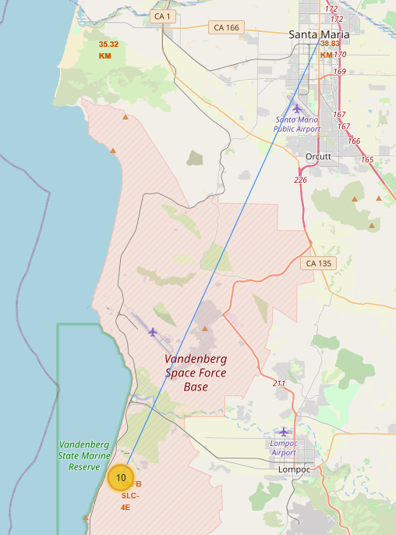
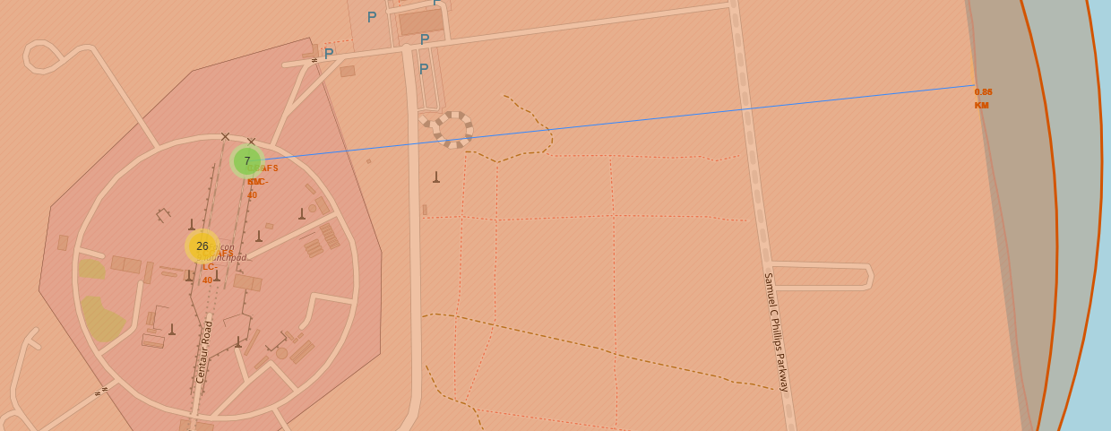
Launch sites proximities
The launches site are in close proximities to the coastline and keep
a certain distance away from the cities.

Slide 42

Section 4

Slide 43
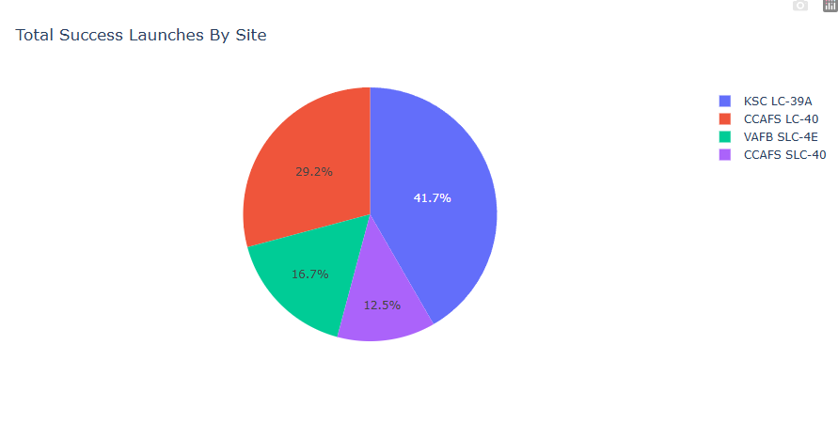
Pie chart with the launch success ratio for all sites
The pie chart shows that site KSC LC-39A has the higher successful rate.

Slide 44
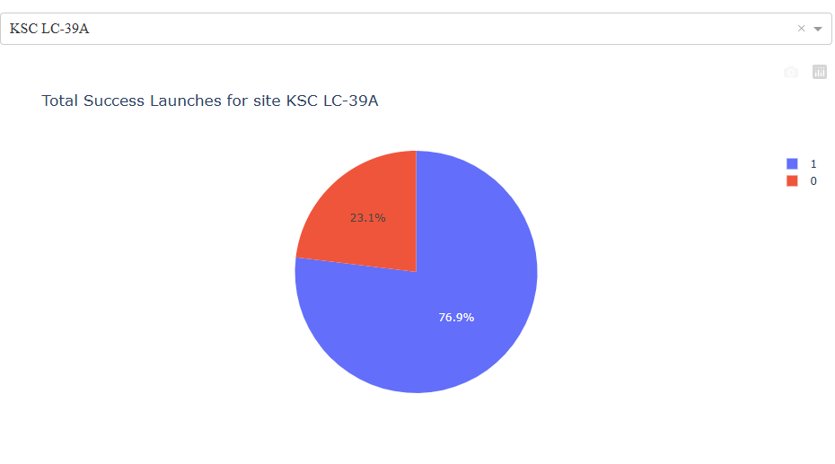
Pie Chart with the highest successful rate
The Pie Chart shows that KSC LC39A site has the highest successful rate.

Slide 45
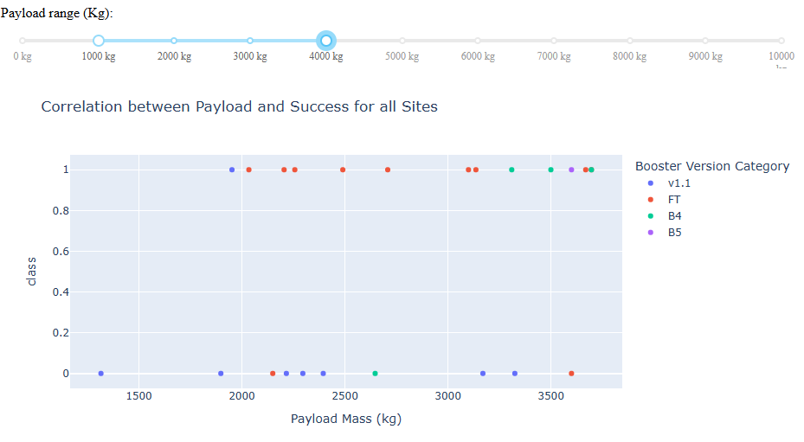
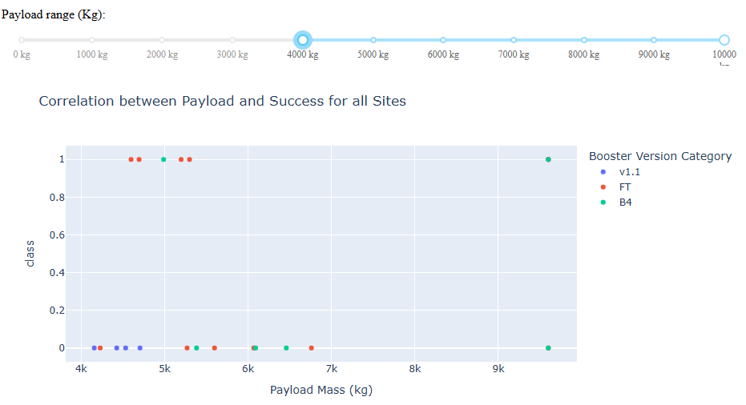
Scatter plot for all sites with different payload selected in the range slider
The scatter plot for different range of payload mass shows that the success rate is higher for low weighted payload.

Slide 46

Section 5

Slide 47
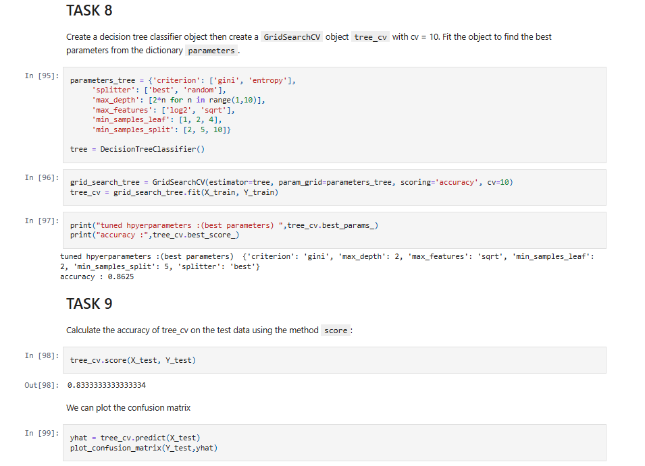
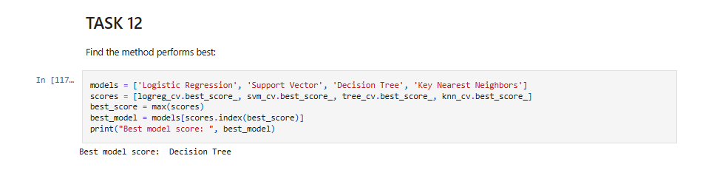
Classification Accuracy
On the left the accuracy for the Decision Tree model;
The Decision Tree model is the model that perform better.

Slide 48
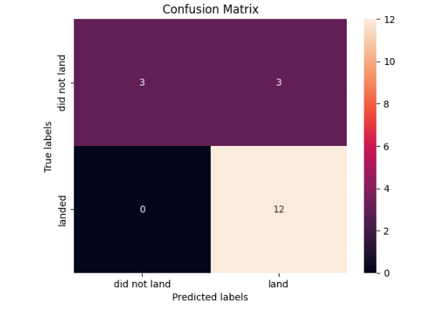
Confusion Matrix
The confusion matrix of the best performing model with. The major drawback, like all the other models, are the false positives.

Slide 49
Conclusions
We can conclude that:
The success rate is very high with a count of 100 success vs 1 failure;
The Orbit types with the highest success rate are ES-L1, GEO, HEO, SSO;
The success rate since 2013 kept increasing till 2020;
All launch sites are in very close proximity to the east and west coast;
The launches site are in close proximities to the coastline and keep a certain distance away from the cities;
KSC LC39A site has the highest successful rate;
The success rate is higher for low weighted payload;
The Decision Tree is the method that performs best.

Slide 50


